Slide 1
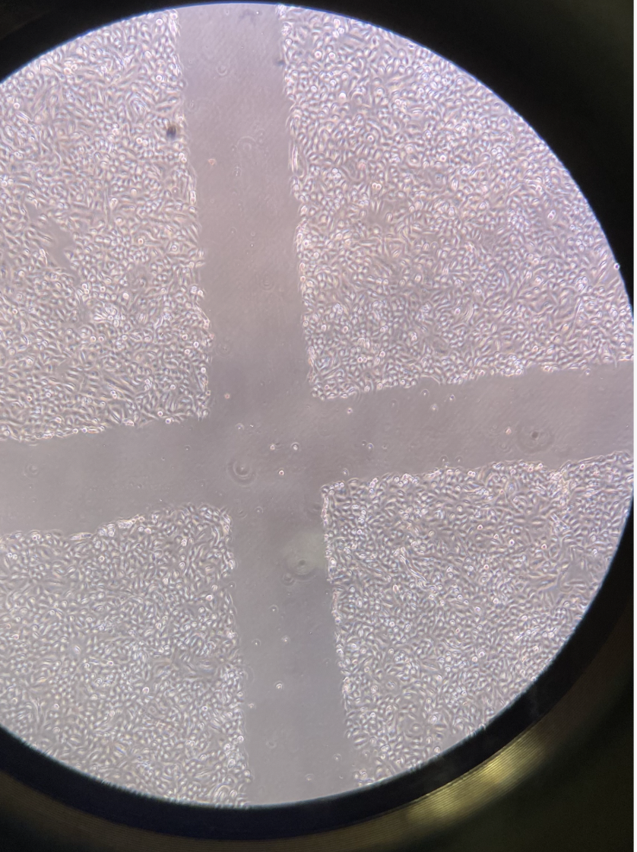
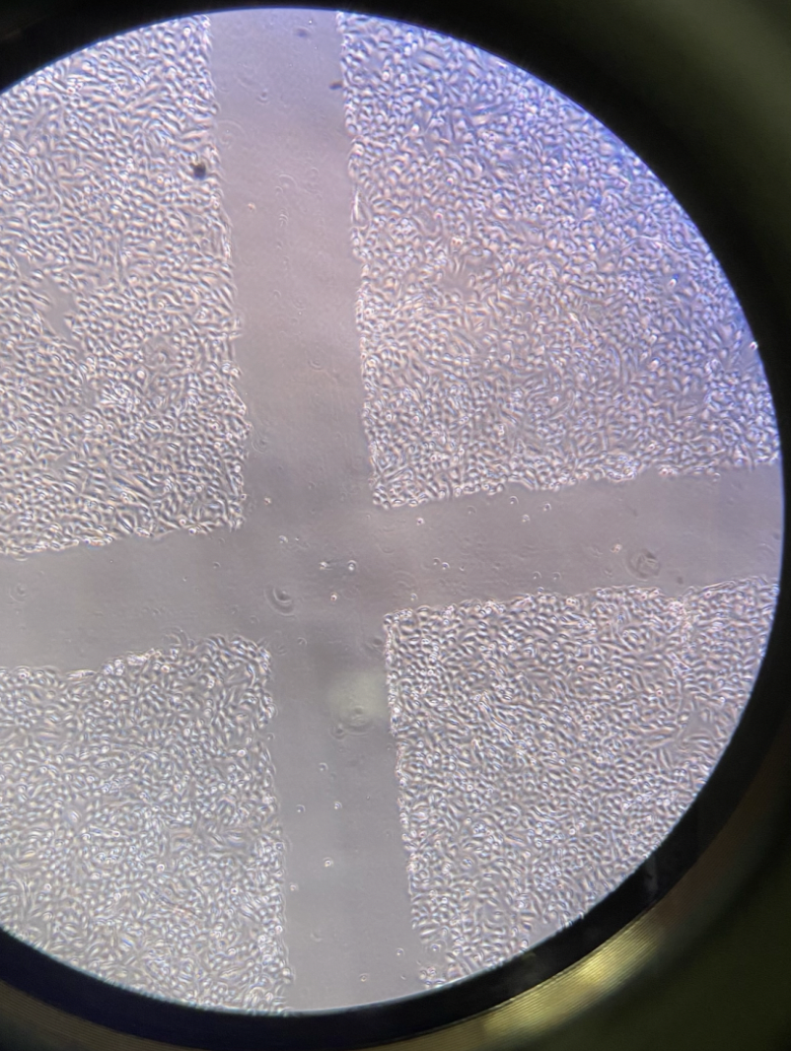
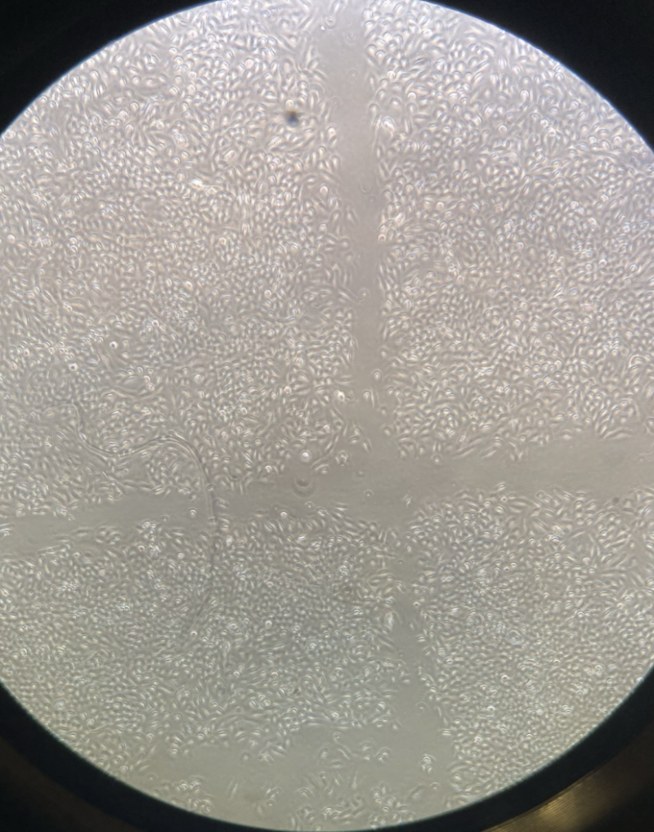
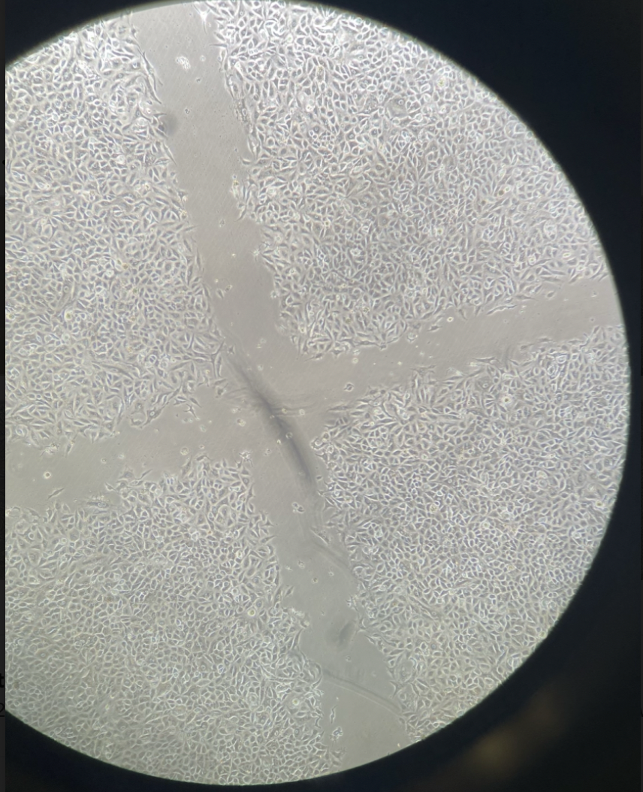
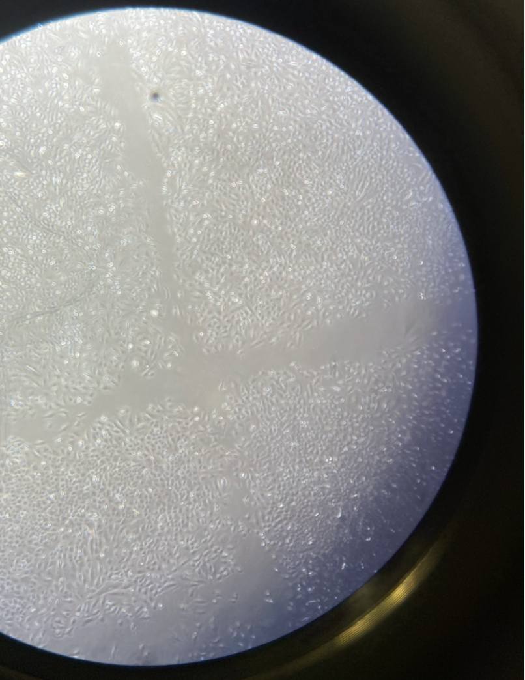
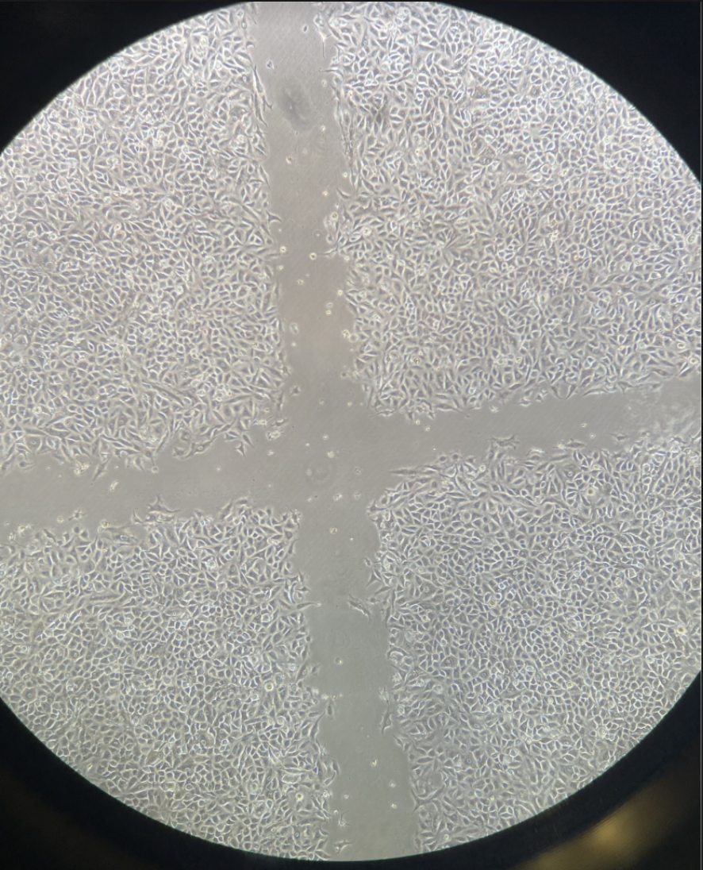
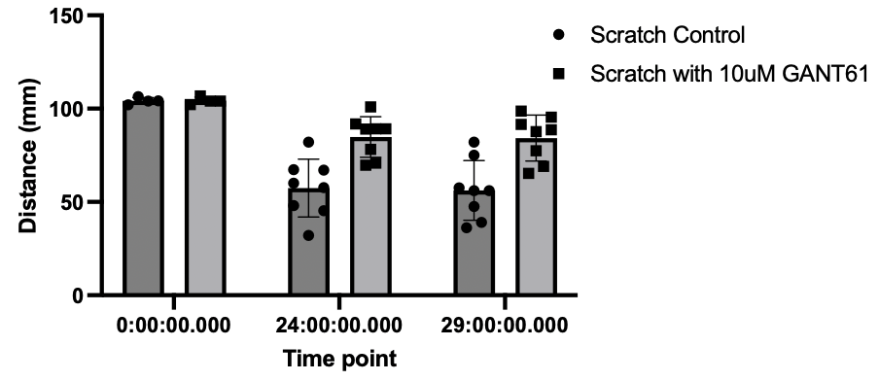
Scratch assay followed by GANT61 (10uM) treatment
0 hrs Scratch
24 hrs Scratch
29 hrs Scratch
Control
10uM GANT61
Control
10uM GANT61
Control
10uM GANT61
***
***
0hrs
24hrs
29hrs

